Slide 1
History Apps/Utah’s Geography
- Utah History -

Slide 2
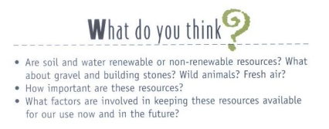
WARM-UP A:1-17-13/B: 1-18-13
Open your textbook.
Read pages 6-8.
Then answer the questions below
You have 9 minutes

Slide 3
Today’s Goals/Outline:
Learn History Apps
Where is Utah?
Utah’s Geography
Assignment: fill out the “History Apps” page of your Unit 1 packet.

Slide 4
History Apps
Analyze
Using what you already know…
What is the landscape like where you live? What factors might influence that?

Slide 5
History Apps
Research
Look for more information
Example: Student Success Presentations

Slide 6
History Apps
Technology
Use computers to find information
“History of” reports…

Slide 7
History Apps
Write
Explain historical findings using evidence
Biographies

Slide 8
History Apps
Recreate
Be creative in remaking a historical person, object or event
Draw a picture of the 2002 Winter Olympics

Slide 9
History Apps
Empathize
Put yourself in someone’s shoes
Write a journal entry as if you are a kindergartener who just went to the zoo for the first time.

Slide 10
History Apps
Connect
How are things related?
How is geography related to history? (think of last time’s warm-up)

Slide 11
History Apps
Organize
Make information easily understood
Make a chart showing the number of students with blue eyes, green eyes, and brown eyes…

Slide 12
Where is Utah???
Planet Earth
Northwest Hemisphere
North America
Western United States

