Slide 1
WARM-UP A: 1-23/B: 1-24
Get a textbook from the bookcase
Read pages 10-15
Then describe each of Utah’s 3 land regions. (2 sentences for each region)
You Have 12 Minutes… Work Hard!

Slide 2
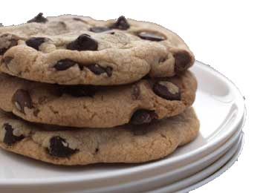
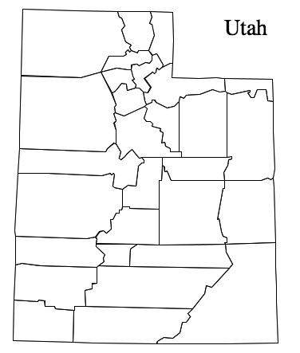
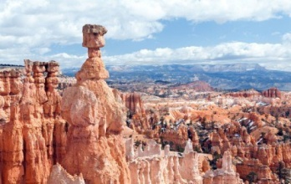
UTAH HISTORY
Unit 1-Becoming a Utah Historian

Slide 3
By the end of today I can say…
I can read and understand how to use a variety of maps. (physical maps, political maps, road maps, thematic maps)
I can identify the three clues to understanding a map.
I can label Utah’s 29 counties on a map

Slide 4
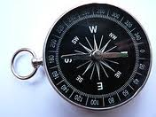
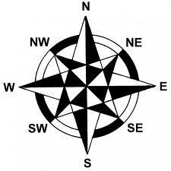
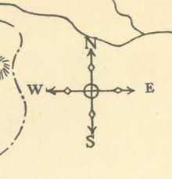
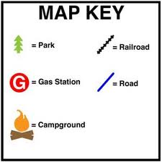
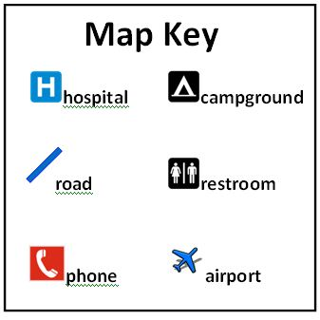
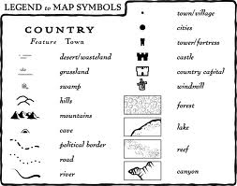
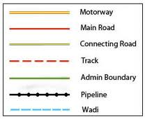
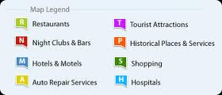
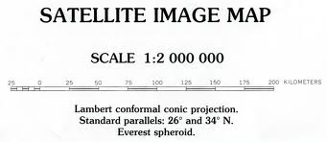
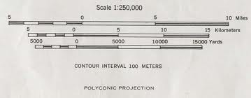
Three essential clues to understand a map.
Compass
Key
Scale

Slide 5
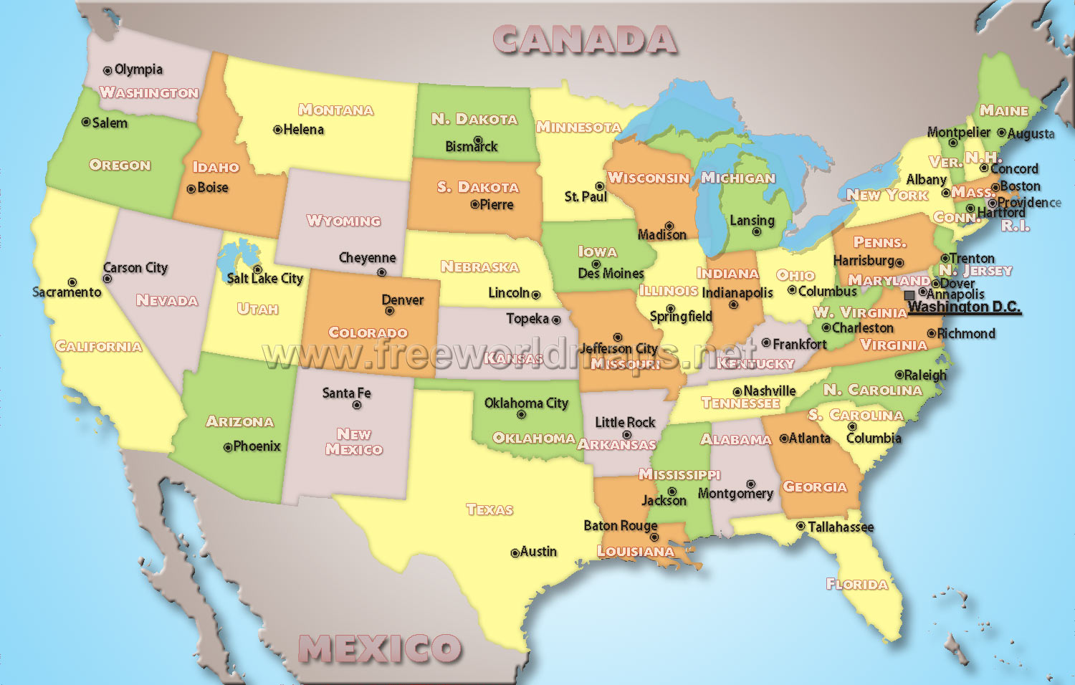
4 kinds of Maps
Political

Slide 6
Physical

Slide 7
Theme

Slide 8
Road

Slide 9
Review
What is the purpose of a political map?
What is the purpose of a physical map?
What is the purpose of a theme map?
What is the purpose of a road map?
What are the three essential clues to understanding a map and what is the purpose of each?
Can you find the US on the following map? What color is it?

Slide 11
29-6-5-4-3-2-1
What it means
How to remember
Break it down

Slide 12
29 – Counties in Utah
Follow the instructions on the top of the page with the Counties of Utah Map

Slide 13
6 – States Surrounding Utah
Idaho
Wyoming
Colorado
New Mexico
Arizona
Nevada
Label each on the map provided in your Unit 1 Packet and color each with a different color.

Slide 14
5 – Utah’s National Parks
Zion
Bryce Canyon
Capitol Reef
Canyon Lands
Arches
Label Each in your Unit 1 Map Packet

Slide 15
4 – Physical Features of Utah
Turn to Page 25 in the textbook
Find 4 Physical Features (mountains, etc.) in Utah and label them in their correct location on the map provided in your Unit 1 Packet.

Slide 16
Utah’s 3 Land Regions
1. Rocky Mountain
2. Great Basin
3. Colorado Plateau

Slide 17
The Rocky Mountain Region
Snow provides water
Recreation
Coal, Copper and other minerals

Slide 18
The Great Basin Region
Large, dry desert
Most cities on edge
Rivers form lakes.

Slide 19
The Colorado Plateau Region
High and flat
Little Rain
Rivers
Colorful Rock
Mineral Resources

Slide 20
2 – Cities in Your County (Utah)
Saratoga Springs
Eagle Mountain
Cedar Fort
Lehi
American Fork
Pleasant Grove
Lindon
Orem
Provo
Alpine
Highland
Springville
Spanish Fork
Payson

Slide 21
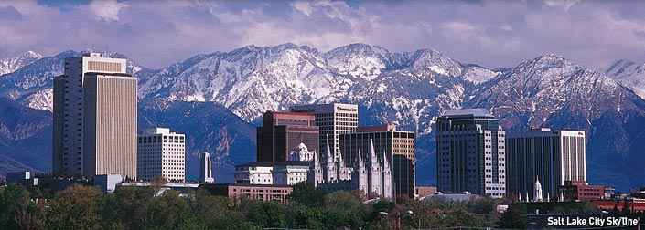
1 – State Capitol
Salt Lake City

