Slide 1
Cause and Effect
What are some common, and easy to see, causes and effects?
CAUSE: it snows…
EFFECT: my hair or jacket gets wet
CAUSE: a student cuts in lunch line…
EFFECT: that students gets in trouble
CAUSE: you do all your homework and study hard…
EFFECT: you’ll get a good grade

Slide 2
Geology is the study of causes and effects of the earth’s surface
What are some geological events?
Identify some in a small group
Earthquakes
Floods
Mudslides
Volcanoes
Avalanches

Slide 3
Effects
Earthquakes
Floods
Mudslides
Volcanoes
Avalanches
What are some effects of these events?
Identify them with a different small group

Slide 4
(Salt Flats and Lake Bonneville)

Slide 5
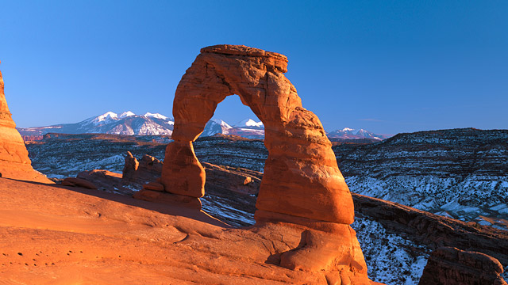
Arches National Park
Bryce Canyon

Slide 6
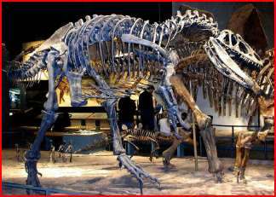
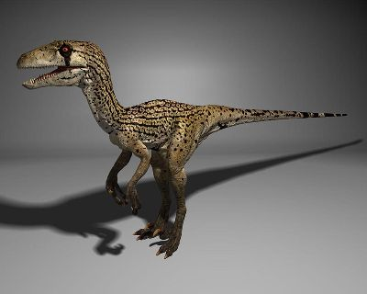
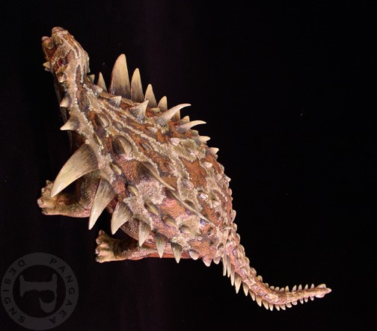
Allosaurus
The Utah Raptor
Gastonia

