Slide 1
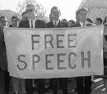
Freedom of Speech
Notes:
‹#›

Slide 2
Quiz 3.1
1- What is the bill of rights?
2- Why was the bill of rights added to the constitution?
3- What is the first amendment?

Slide 3
LSWYK
Which of the specific rights guaranteed by the First Amendment can you name?
In the U.S. is it legal to burn the flag as a means of political protest?
Can a public university censor a student newspaper?
What does it mean to be “free”?
What does it mean to “have rights”?

Slide 4
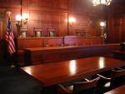
Courts distinguish different types of Speech
Many actions can be a type of speech
Verbal
Non-verbal – Wearing a shirt, shaving your head
Notes:
‹#›

Slide 5
Protected Speech
2 types of speech protected by 1stAmendment
Notes:
‹#›

Slide 6
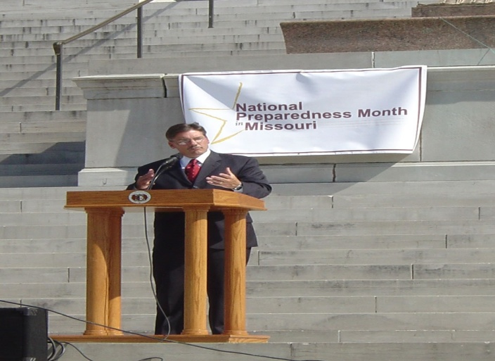
Pure Speech
Verbal expression of thought or opinion before an audience that has chosen to listen
Examples: dinner table, church, political assembly
Notes:
‹#›

Slide 7
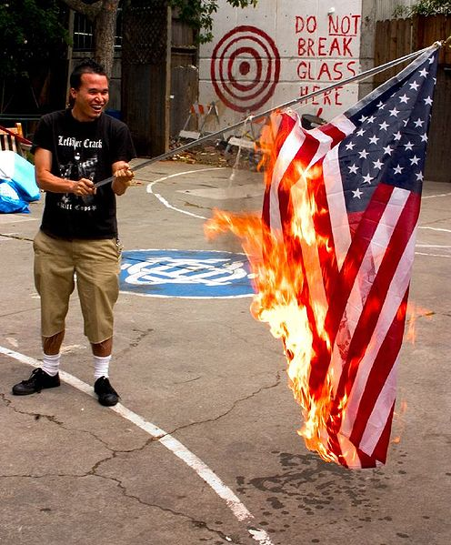
Symbolic Speech
Using actions or symbols, with or without words, to express opinions
Ex. Burning US flags to protest Vietnam War
Restrictions??
Ex. Attacks on Abortion Clinics
Court has ruled 1st Amendment does not permit actions that threaten public safety
Notes:
‹#›

Slide 8
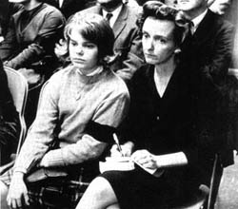
Tinker v Des Moines (1969)
Students wore black arm band to protest Vietnam War.
The students were suspended from school for violating the school’s dress code.
Their parents sued the school district!
The Tinkers claimed suspension violated their first amendment right to Free Speech.
What do you think? Can the school district tell kids what they can and can not wear?
Notes:
‹#›

Slide 9
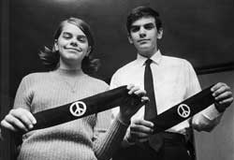
Court Room Decisions
Tinker v. Des Moines (1969)- Court ruled that students could wear black armbands in protest of Vietnam war
What type of speech is this case?
Notes:
‹#›

Slide 10
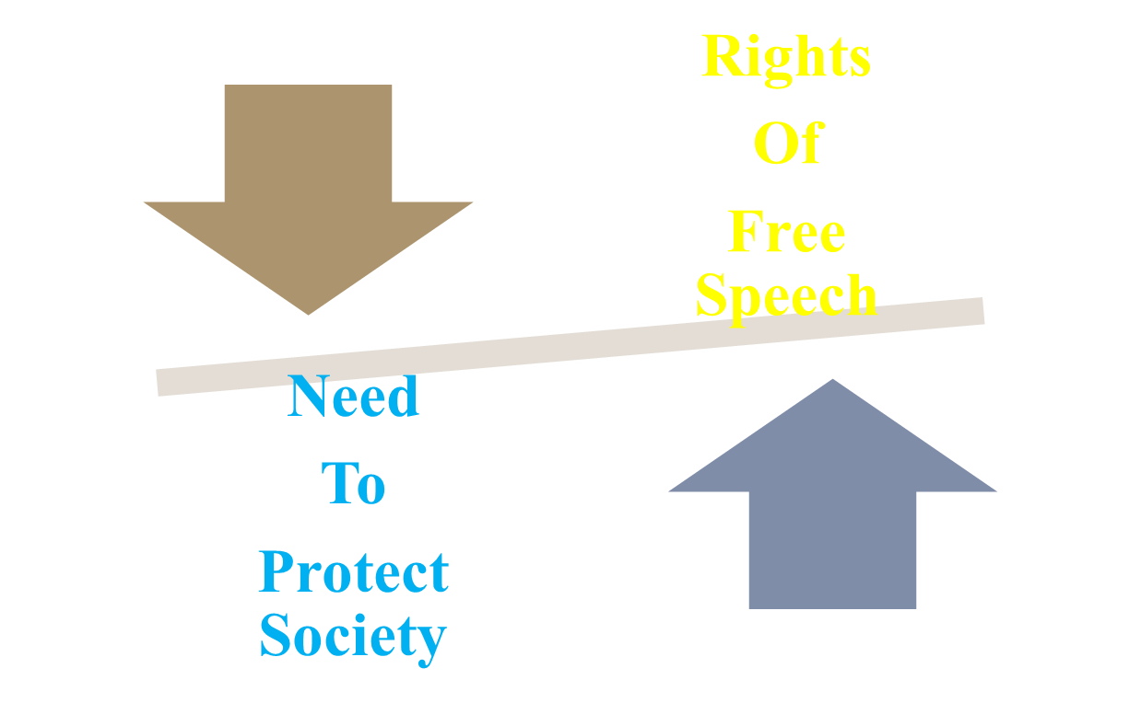
Regulating Speech
Notes:
‹#›

Slide 11
Court’s decisions based on 3 views
“Clear and Present Danger”- if speech presents an immediate danger it is not protected by the 1st amendment
Ex. Public Safety Issue- Terrorist Threat
Notes:
‹#›

Slide 12
View #2- Bad Tendency Doctrine
Restricted even more speech
Example: If speech might lead to illegal action
Q: What do supporters of this view consider more important, maintaining social order or protecting basic freedoms?
A: Maintaining Social Order
Notes:
‹#›

Slide 13
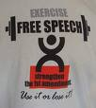
View #3- Preferred Position Doctrine
1st Amendment freedoms are more fundamental than any other freedoms
SO… if a law prohibits freedoms it must be absolutely necessary or it is unconstitutional
Notes:
‹#›

Slide 14
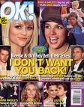
Types of Speech NOT Protected
1. Defamatory Speech- false speech that damages a person’s good name, character, or reputation
2 Types
Slander- Spoken
Libel- written
Notes:
‹#›

Slide 15
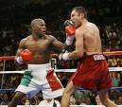
Types of Speech NOT Protected
2. “Fighting Words”- insulting words that provoke immediate violence
“any offensive, derisive, or annoying word to any other person who is lawfully in any street or public place”
Notes:
‹#›

Slide 16
Types of Speech NOT Protected
3. Student Speech- profane and indecent speech on school property or at school events is subject to suspension
The same speech is
protected outside school
Notes:
‹#›

Slide 17
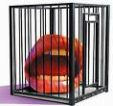
Student Speech
Tinker v. Des Moines- ruled that students do not give up all their freedoms in school
Bethel School District v. Fraser (1986)- ruled that school officials can decide what manner of speech is appropriate in school
Court established a distinction between
Student’s personal expression
Speech appropriate in school
Notes:
‹#›

Slide 18
Schenck vs USA
Facts of the Case
During World War I, Schenck mailed circulars to draftees. The circulars suggested that the draft was a monstrous wrong motivated by the capitalist system. The circulars urged "Do not submit to intimidation" but advised only peaceful action such as petitioning to repeal the Conscription Act. Schenck was charged with conspiracy to violate the Espionage Act by attempting to cause insubordination in the military and to obstruct recruitment.
Question
Are Schenck's actions (words, expression) protected by the free speech clause of the First Amendment?

Slide 19
Schenck vs USA
Conclusion
Decision: 9 votes for United States, 0 vote(s) against Legal provision: 1917 Espionage Act; US Const Amend 1
Holmes, speaking for a unanimous Court, concluded that Schenck is not protected in this situation. The character of every act depends on the circumstances. "The question in every case is whether the words used are used in such circumstances and are of such a nature as to create a clear and present danger that they will bring about the substantive evils that Congress has a right to prevent." During wartime, utterances tolerable in peacetime can be punished.

Slide 20
Texas vs Johnson
Facts of the Case
In 1984, in front of the Dallas City Hall, Gregory Lee Johnson burned an American flag as a means of protest against Reagan administration policies. Johnson was tried and convicted under a Texas law outlawing flag desecration. He was sentenced to one year in jail and assessed a $2,000 fine. After the Texas Court of Criminal Appeals reversed the conviction, the case went to the Supreme Court.
Question
Is the desecration of an American flag, by burning or otherwise, a form of speech that is protected under the First Amendment?

Slide 21
Texas vs Johnson
Conclusion
Decision: 5 votes for Johnson, 4 vote(s) against Legal provision: Amendment 1: Speech, Press, and Assembly
In a 5-to-4 decision, the Court held that Johnson's burning of a flag was protected expression under the First Amendment. The Court found that Johnson's actions fell into the category of expressive conduct and had a distinctively political nature. The fact that an audience takes offense to certain ideas or expression, the Court found, does not justify prohibitions of speech. The Court also held that state officials did not have the authority to designate symbols to be used to communicate only limited sets of messages, noting that "[i]f there is a bedrock principle underlying the First Amendment, it is that the Government may not prohibit the expression of an idea simply because society finds the idea itself offensive or disagreeable."

Slide 22
Bethel School District vs Fraser
Facts of the Case
At a school assembly of approximately 600 high school students, Matthew Fraser made a speech nominating a fellow student for elective office. In his speech, Fraser used what some observers believed was a graphic sexual metaphor to promote the candidacy of his friend. As part of its disciplinary code, Bethel High School enforced a rule prohibiting conduct which "substantially interferes with the educational process . . . including the use of obscene, profane language or gestures." Fraser was suspended from school for two days.
Question
Does the First Amendment prevent a school district from disciplining a high school student for giving a lewd speech at a high school assembly?

Slide 23
Bethel School District vs Fraser
Conclusion
Decision: 7 votes for Bethel School District No. 403, 2 vote(s) against Legal provision: Amendment 1: Speech, Press, and Assembly
No. The Court found that it was appropriate for the school to prohibit the use of vulgar and offensive language. Chief Justice Burger distinguished between political speech which the Court previously had protected in Tinker v. Des Moines Independent Community School District (1969) and the supposed sexual content of Fraser's message at the assembly. Burger concluded that the First Amendment did not prohibit schools from prohibiting vulgar and lewd speech since such discourse was inconsistent with the "fundamental values of public school education."

Slide 24
Chaplinsky vs New Hampshire
Facts of the Case
Chaplinsky, called a city marshal a "God-damned racketeer" and "a damned fascist" in a public place. He was arrested and convicted under a state law for violating a breach of the peace.
Question
Does the application of the statute violate Chaplinsky's freedom of speech protected by the First Amendment?

Slide 25
Chaplinsky vs New Hampshire
Conclusion
No. Some forms of expression--among them obscenity and fighting words--do not convey ideas and thus are not subject to First Amendment protection. In this case, Chaplinsky uttered fighting words, i.e., words that "inflict injury or tend to incite an immediate breach of the peace."

