Slide 1
WARM-UP A: 2-28-13/ B:3-1-13
Write 5 sentences explain the grid system and how Utah was settled. Make sure to use your own words. Pretend you are telling someone who doesn’t know anything about Utah.
(this is what we covered last time-if you were absent read the first part of pg. 122 first)

Slide 2
THINKING QUESTION
Why do people of different cultures often misunderstand each other?

Slide 3
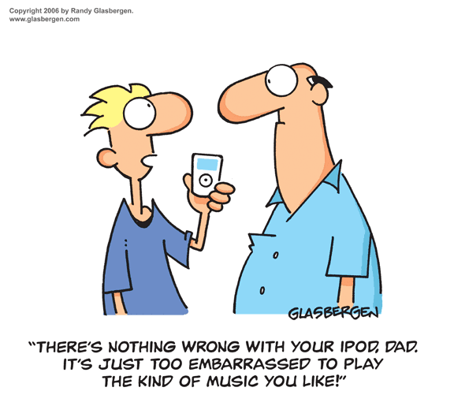
Clash of Cultures?

Slide 4
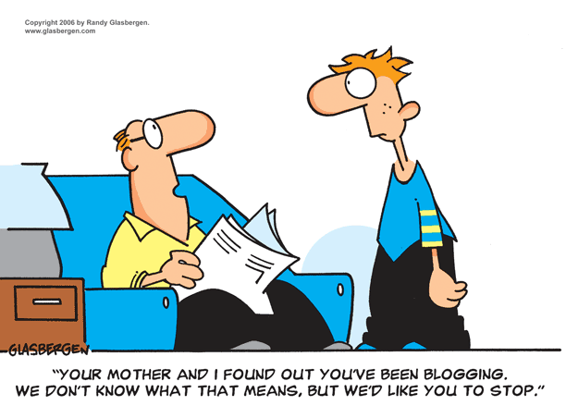
Clash of Cultures?

Slide 5
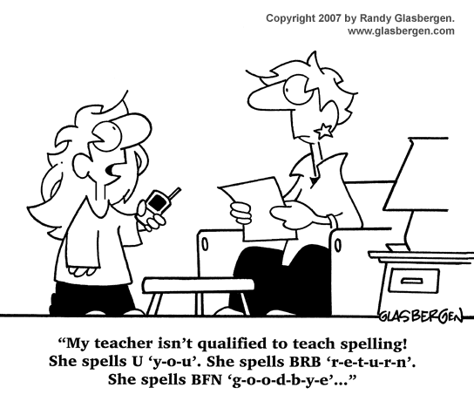
Clash of Cultures?

Slide 6
Have you ever experienced a Clash of Cultures?

Slide 7
To set the stage:
REMEMBER THAT:
The Mormon Pioneers had to move West, and came to live in the Salt Lake Valley.
They settled the state and developed the grid system.
Brigham Young sent people to various parts of the Territory to start towns.
In the meantime, the lives of native Indian groups started changing drastically.
The rest of the country has not forgotten their “issues” with the Mormons.

Slide 8
Utah is a Territory in Turmoil
There were conflicts between:
Conflict Among the Tribes
Settlers and the U.S. Government
Indians and Settlers

Slide 9
Examples of Conflict…

Slide 10
Conflict Among the Tribes
The Shoshone, Ute and Paiutes bore a strong animosity toward each other.
WHAT DOES THE WORD ANIMOSITY MEAN?

Slide 11
Government and Settlers
Unfavorable reports from the Utah Territory were sent back to Washington D.C.
The government was prepared to go to war with the people of the Utah Territory.
Brigham Young believed that the U.S. government wanted to destroy their religious community.
This conflict is known as the Utah War.
In the end, they decided to make a comprise and appointed a new governor. (there was no fighting)

Slide 12
Mountain Meadows Massacre
SETTLERS
120 of the Baker-Fancher Party from Arkansas and Missouri s on their way to California.
The Mormons heard rumors that the travelers coming to the area were murderous, and a threat to their town. They were frightened and not sure what to do.
Mormons joined with Paiutes to fight, and killed all the men, women, and children old enough to report what happened.

Slide 13
INDIANS AND SETTLERS
Now fill out the Indians and Settlers predictions

Slide 14
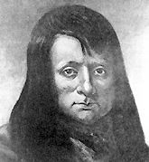
The Walkara War
INDIANS AND SETTLERS
Reasons for the Walkara War
1) Constant arrival of thousands of pioneers into the territory.
2) Fewer animals to hunt for food.
3) Decline in Indian population resulting form the white man’s diseases.
4) Brigham Young interfered with the Walkara slave trading.

Slide 15
Goshute War
INDIANS AND SETTLERS
Settlers were trying to establish an overland route between Missouri and California.
Goshutes attacked settlers who were trying to take away their land.
The Goshute War resulted in the deaths of sixteen settlers and over 100 Indians.

Slide 16
The Blackhawk War
INDIANS AND SETTLERS
The Black Hawk War was the longest and most destructive conflict in Utah.
Brigham Young and a government agent met with local Indian leaders to sign a treaty. The Indians were required to giving up their tribal lands and agreed to move their people to the Uintah Reservation. Black Hawk refused.
In 1864, President Abraham Lincoln passed the Indian Removal Act. This required the Indians of Utah to sell lands and move to the Uintah Basin.
The largest massacre of Indians during this war occurred at Circleville, when at least 16 unarmed Paiute Indians, including women and children were killed most had their throats slit. Despite pleas for an investigation, government officials took no action.

Slide 17
Video Clip
WE SHALL REMAIN: The Ute
What is your reaction to the video?

Slide 18
Clash of Cultures
Native Americans
1) Indians did not understand why Mormons, had so many rules and harsh discipline.
2) Indians didn’t understand why farming was so important to settlers when food was provided by nature.
Settlers
1) The settlers didn’t understand why Indians abandoned their elderly to die.
2) Settlers didn’t understand why Indians killed a dead warrior’s horse and slaves so they could go to the spirit world.
3) Settlers also didn’t understand why Indians stole children from other tribes and sold them to Spanish as slaves.

Slide 19
Major Indian/White Conflicts
There are several reasons why the settlers won most of the battles:
1) The Indians were never totally united
2) The Indians were outnumbered.
3) The Indians weapons were inferior.

