Slide 1
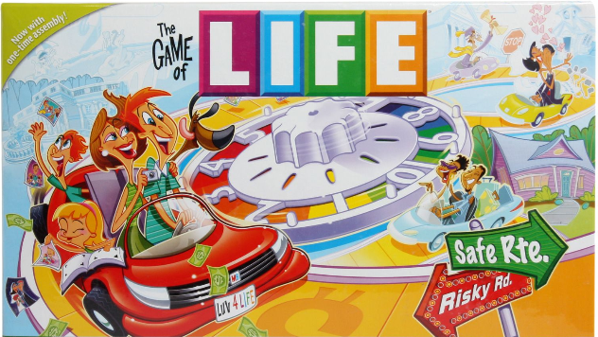
The Great Depression Edition

Slide 2
Rules of the Game
You are now a 30 year old living in the early 1900s
You will be rolling the dice to find out your fate for each round of the game
You can not change the outcome of your fate
Make sure everyone takes a turn, even if they’ve “given up”
Everyone starts out with $100

Slide 3
Round 1 October 28th, 1929
Choose one person in your group to be the banker
(they are NOT exempt from fate and the money will NOT belong to them-they just manage the money lost or gained)
Everyone else will roll the dice to find out their occupation:
1: Mexican Immigrant ranch hand | 4: Japanese Immigrant farmer
2: Greek Immigrant miner | 5: Jewish Immigrant chicken farmer
3: Chinese Immigrant Restaurant Owner | 6: American Factory Owner

Slide 4
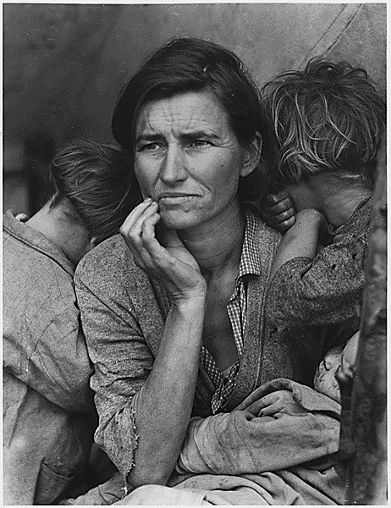
October 29th, 1929 “Black Tuesday”
What Happened?

Slide 5
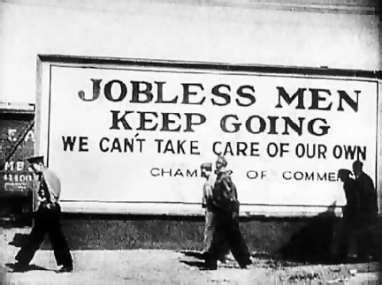
Round 2 1930
1: You’ve lost ½ your business/crops (give ½ your money to the banker) | 4:You’ve lost your job. Give ¾ of your money to the banker.
2: You’ve lost your job, but you are self-sufficient, so only give ¼ of your money to the banker | 5: You’ve lost your job. Give ¾ of your money to the banker.
3: You’ve lost ½ your business/crops (give ½ your money to the banker) | 6: You’ve lost your job. Give ¾ of your money to the banker.
(Round if you need to)
Reflection: What can you do if you’ve lost your job but you still need to eat?
How it affected the nation

Slide 6
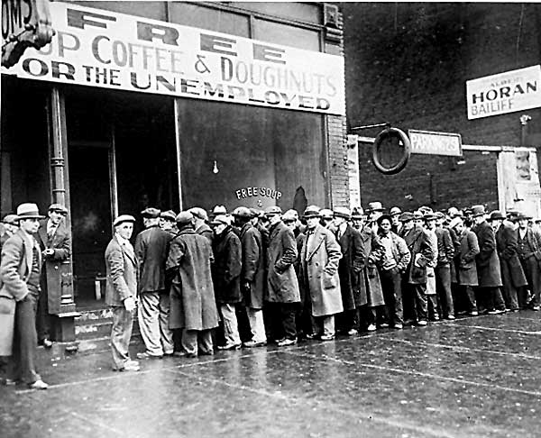
Round 3 1932
1: You still haven’t found a job. Give ½ of your remaining money to the banker. | 4: You still haven’t found a job. Give ½ of your remaining money to the banker.
2: You still haven’t found a job, but the people in your community are working together to help each other survive. Give $10 to the banker. | 5: You still haven’t found a job, but the people in your community are working together to help each other survive. Give $10 to the banker.
3: You still haven’t found a job. Give ½ of your remaining money to the banker. | 6: You found a job. You don’t make much, but you don’t need to give anything to the banker.
(Round if you need to)

Slide 7
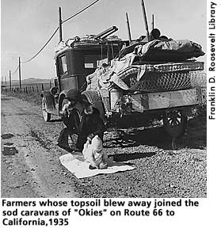
Round 4 1935
The Dust Bowl hits Utah
1: You’ve had a farm to feed your family or make some money. The drought ruins the crops and you’re forced to move in hopes of better land. | 4: Your farm is drier, but you live in a good area that is well-irrigated from a large river. You don’t need to move.
2: Your farm is drier, but you live in a good area that is well-irrigated from a large river. You don’t need to move. | 5: You’ve agreed to help your neighbors’ children while they find a new home in California. Give $10 to the bank.
3: You don’t have enough land for a farm, but your crop supplier moved. Give $10 to the banker. | 6: You don’t have enough land for a farm, but your crop supplier moved. Give $10 to the banker.

Slide 8
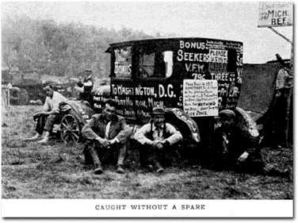
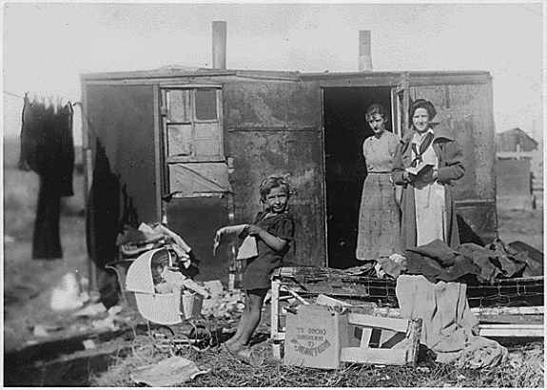
Reflection
Is there any hope for you and your family??
What would you suggest to help Utah recover from this financial crisis?

Slide 9
A New Approach to Governing the Nation

Slide 10
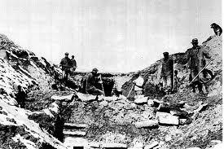
Late 1930’s Help from President Roosevelt
1: You receive help from the “alphabet soup” of the New Deal. Get $30 from the banker. | 4: Your farm starts recovering and the “alphabet soup” of the New Deal helps your family. Get $20 from the banker.
2: You get a job through the “alphabet soup” of the New Deal. Receive $20 from the banker. | 5: You get a job through the “alphabet soup” of the New Deal. Get $20 from the banker.
3: Your farm starts recovering and the “alphabet soup” of the New Deal helps your family. Get $20 from the banker. | 6: You receive help from the “alphabet soup” of the New Deal. Get $30 from the banker.

Slide 11
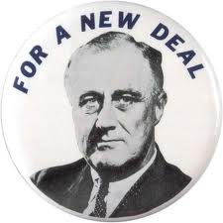
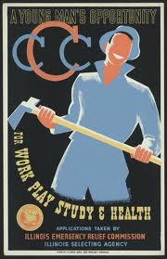
Reflection
The 3 R’s of the NEW DEAL
The CCC
The WPA
The FERA
The CWA

Slide 12
Final Reflection
Have you made all your money back? Is the work you do through the help of the New Deal the job you really want? Is everything back to “normal” (what you had before the Stock Market crashed)?
Answer in 2-3 complete sentences
How did the Great Depression have an effect on Utah?
Answer in 2-3 complete sentences

Slide 13
Relief and recovery Workers
Men
Women
Minorities

