Slide 1
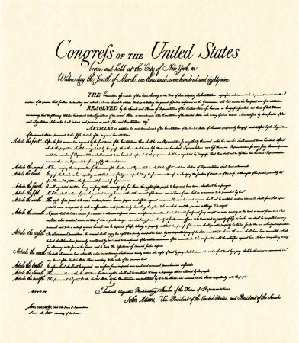
The Bill of Rights The First 10 Amendments to the Constitution
Notes:
1

Slide 2
1st Amendment
The 1st Amendment guarantees freedom of religion, speech, the press, assembly, and petition.
This means that we all have the right to:
practice any religion we want to
to speak freely
to assemble (meet)
to address the government (petition)
to publish newspapers, TV, radio, Internet (press)
Notes:
2

Slide 3
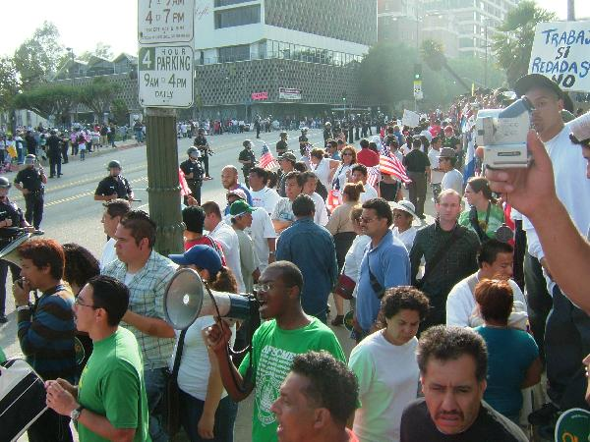
Notes:
3

Slide 4
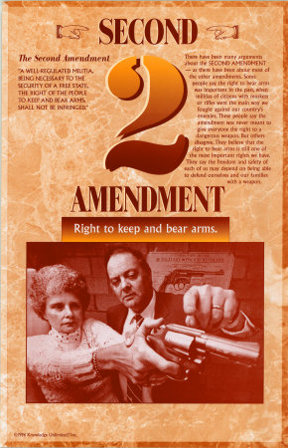
2nd Amendment
The 2nd Amendment protects the right to bear arms, which means the right to own a gun.
Notes:
4

Slide 5
3rd Amendment
The 3rd Amendment says “No soldier shall, in time of peace be quartered in any house, without the consent of the owner, nor in time of war, but in a manner to be prescribed by law.”
This means that we cannot be forced to house or quarter soldiers.
Notes:
5
One of the least litigated amendments, sometimes used by the Supreme Court to imply we have the right to privacy in our own homes. Also shows somewhat that the founding fathers wanted to limit the executive powers even in times of war.

Slide 6
4th Amendment
The 4th Amendment protects the people from unreasonable searches and seizures.
This means that the police must have a warrant to enter our homes. It also means the government cannot take our property, papers, or us, without a valid warrant based on probable cause (good reason).
Notes:
6

Slide 7
5th Amendment
The 5th Amendment protects people from being held for committing a crime unless they are properly indicted, (accused)
You may not be tried twice for the same crime (double jeopardy)
You don’t have to testify against yourself in court. (Self-incrimination)
Notes:
7

Slide 8
6th Amendment
The 6th Amendment guarantees a speedy trial (you can’t be kept in jail for over a year without a trial)
an impartial jury (doesn’t already think you are guilty)
that the accused can confront witnesses against them
the accused must be allowed to have a lawyer
Notes:
8

Slide 9
7th Amendment
The 7th Amendment guarantees the right to a speedy civil trial.
A civil trial differs from a criminal trial. A civil trial is when someone sues someone else. A criminal trial is when the state tries to convict someone of a crime.
Notes:
9

Slide 10
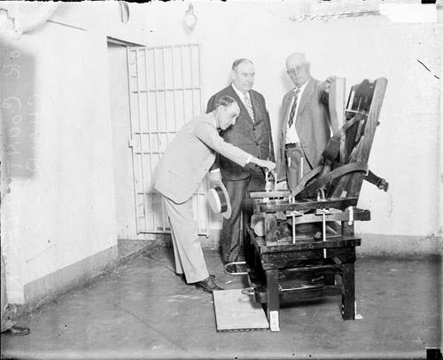
8th Amendment
The 8th Amendment guarantees that punishments will be fair and not cruel, and that extraordinarily large fines will not be set.
Notes:
10

Slide 11
9th Amendment
All rights not stated in the Constitution and not forbidden by the Constitution belong to the people.
This means that the states can do what they want if the Constitution does not forbid it.
Notes:
11

Slide 12
10th Amendment
The 10th Amendment states that any power not granted to the federal government belongs to the states or to the people.
Notes:
12

