Slide 1
Budget: Your money is where your heart is.

Slide 2
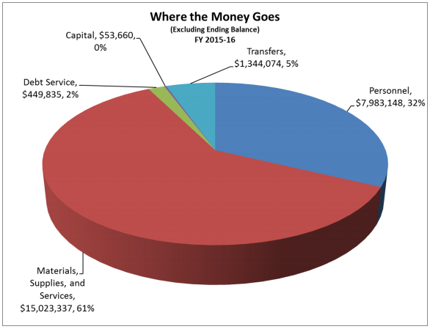
What do we care about?
This pie chart shows how the municipality of Saratoga Springs spends its revenue. What is the largest cost for the municipality of Saratoga Springs?

Slide 3
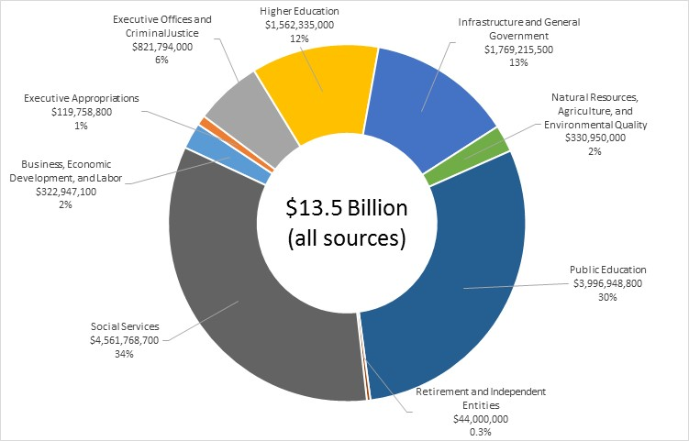
How about the state of Utah?

Slide 4
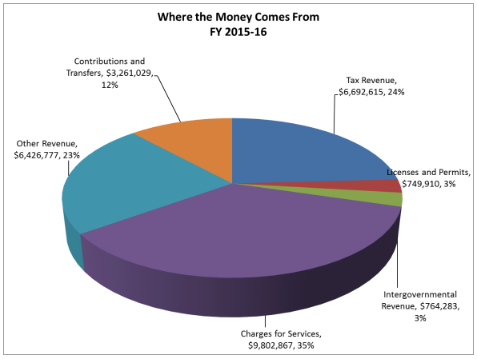
Where does this money come from?
Saratoga Springs:
What is the most fair way to generate revenue? Are there people who benefit without contributing? Do people contribute without benefiting? Do the rich pay more? Should they?

Slide 5
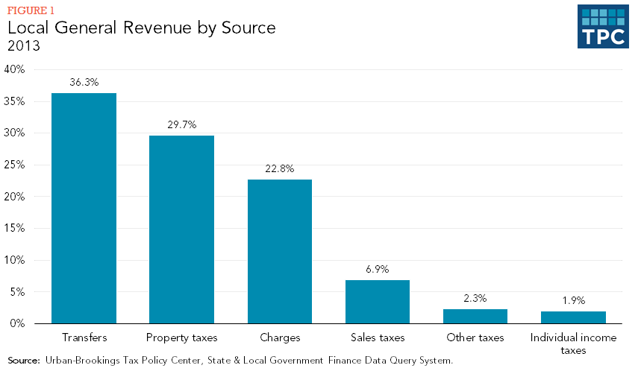
This is a national average for municipal, county, and district governments. How does the national average compare to Saratoga Springs?

Slide 6
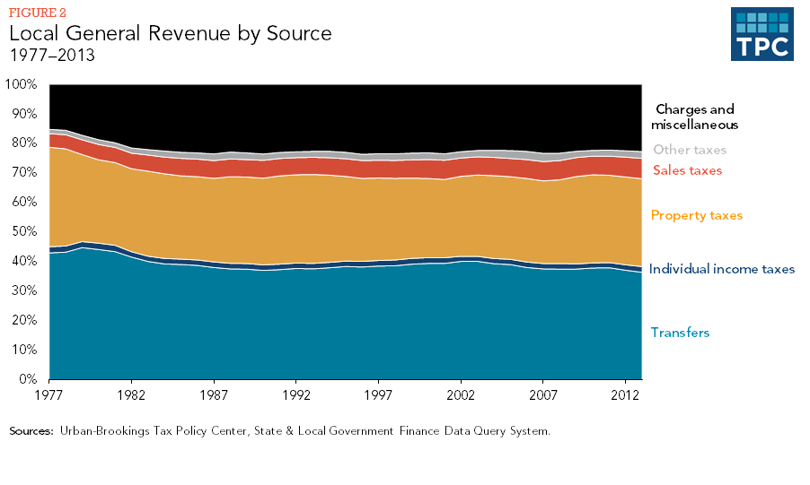

Slide 7
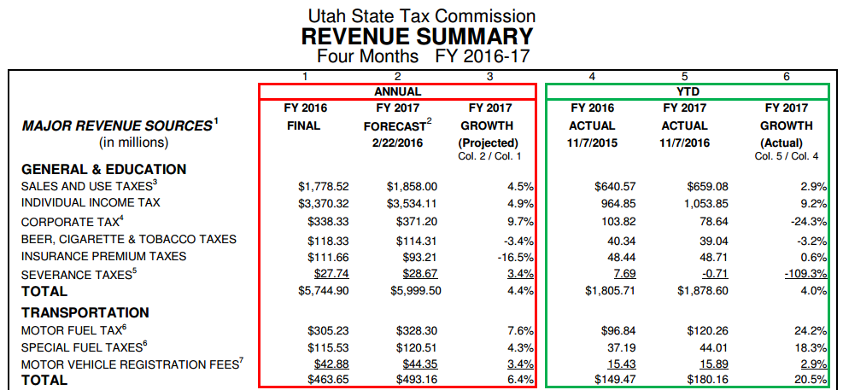
Where does the revenue for the state of Utah come from?

Slide 8
What does a government communicate by creating a certain type of tax?
Progressive tax: Based on ability to pay. The more you can afford, the more you pay. Ex- income tax
Proportional tax: flat tax where everyone pays the same percent%. Ex- property tax.
Regressive tax: proportional tax on a necessity. Called regressive because it ends up representing a larger % of lower income. It is harder for lower income people to pay. Ex- Sales tax on food.
Excise tax: special sales tax on specific purchases. Sometimes called “Sin Tax”. EX- gasoline tax or cigarette tax.

Slide 9
Regressive tax explained.
Mr. Rich has $1000.
Mr. Poor has $10
Both buy a loaf of bread. The bread cost $2.00. They both pay $.13 in taxes.
The $.13 represents just .013% of Mr. Rich’s money.
The same $.13 represents 1.3% of Mr. Poor’s money.
Mr. Poor misses the $.13 a lot more then Mr. Rich does. That is why the sales tax on food is called regressive.

Slide 10
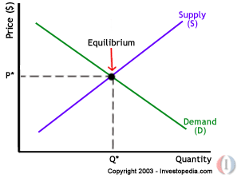
In addition to raising revenue to meet needs and provide services, governments can play a major role in their economies.
Fiscal Policy: Government Taxing and Spending.
When taxes are raised or lowered, the economy notices. If taxes are lowered, residents have more money to spend. Maybe they spend it at local businesses. Also lower taxes might encourage more business to locate in the city instead of somewhere else.
If taxes are lowered to the point that the government can’t provide the services that people expect, that could have the opposite effect. Local spending might be discouraged and business might choose somewhere else where they can count on government services.

Slide 11
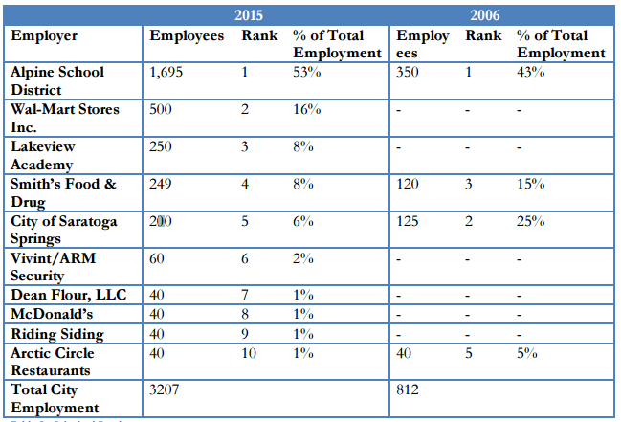
We notice government spending too.
Who is the largest employer in Saratoga Springs? If that employer decided to cut spending by reducing the wages and salaries of their employees, would the city and its economy notice?

Slide 12
Can a municipal or state government use fiscal policy to help a slow economy? Should they? How would you do it? What risk do you take?

Slide 13
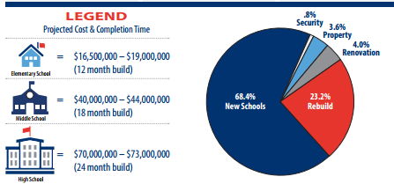
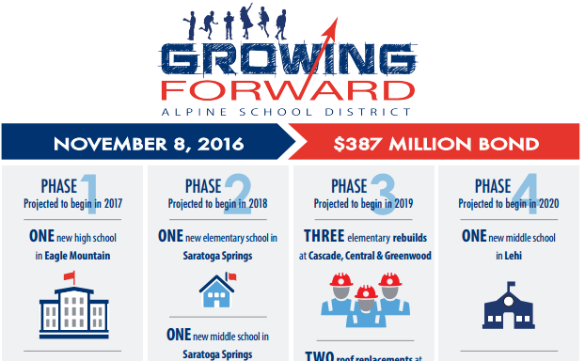
What about when governments want or need to spend money that they don’t have?

Slide 14
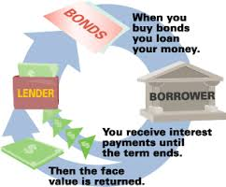
Governments borrow money by issuing BONDS
Governments don’t borrow from banks like you or I would. They sell bonds to investors like you and me. Investors play the role of banker and the government plays the role of borrower.

Slide 15
Governments build into future budgets their obligations to pay back their bond debt.

Slide 16
