Slide 1
Economic Systems Capitalism, Socialism & Communism
Liberty or Equality?

Slide 2
Which is more important: Liberty or Equality?
What is Liberty?
What is Equality?

Slide 3
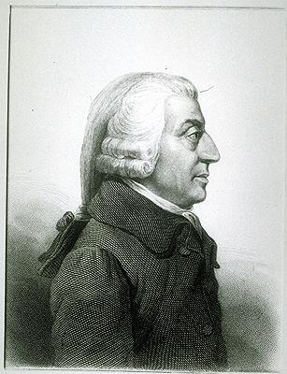
Capitalism
Maximizes liberty
Adam Smith – 1776 – “The Wealth of Nations”
“Free Enterprise” – everyone is free to pursue any economic activity
Laissez-Faire – do not interfere in the economy
Freedom to succeed and freedom to fail
Private ownership of capital (means of production)

Slide 4
Capitalism
Profit is the motivator, competition is the regulator (not government)
Under pure capitalism, almost all goods would be provided by the private sector (small government) – police, courts, military (even schools and the fire department could be private goods)
Do not tax the rich more than the poor – no redistribution of income
Good of the individual is above society
Bill Gates and Hobo Joe

Slide 5
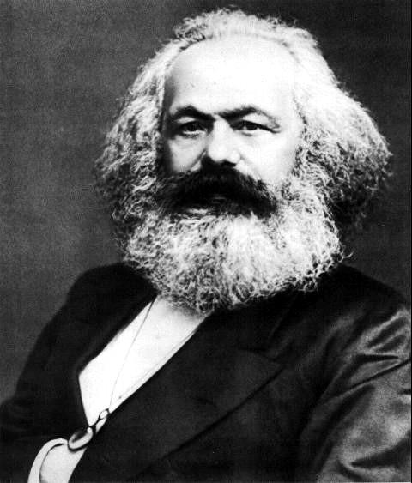
Communism
Maximizes Equality
Karl Marx – 1848 - “The Communist Manifesto”
Industrial Revolution – Europe – horrible working conditions - critique of capitalism
1. View of History – class struggle (bourgeoisie and proletariat)
2. Labor Theory of Value – all value comes from labor
3. Nature of the State – the state (government) always sides with the rich
4. Dictatorship of the Proletariat – poor must overthrow the government and set up a classless society

Slide 6
Communism
Public (government) ownership of the means of production
“From each according to his ability, to each according to his need.”
Workers run the factories – everyone earns an equal amount
Lots of government intervention in the economy to promote equality
Good of society is above the individual
Bill Gates and Hobo Joe

Slide 7
Socialism
Mix of Equality and Liberty
Between pure capitalism and pure communism
Some private ownership and some public ownership of property
Some government intervention in the economy
Redistribution of income – high taxes on the rich to provide lots of government services
Examples of government programs like this in the USA?
Bill Gates and Hobo Joe?

