Slide 1
February 22 and 25, 2013 Utah History
In 5 complete sentences answer the following prompt:
Imagine you lost all your physical possessions in a fire, what would you miss the most? Explain what makes that item so much more important than other items.
Generally speaking what makes something valuable to you?

Slide 2
Class Objectives
I can explain why the Mormons moved west.
I understand some of the challenges Mormon pioneers faced on their trek to Utah.
I can identify points along the trail travelled by Mormon pioneers.

Slide 3
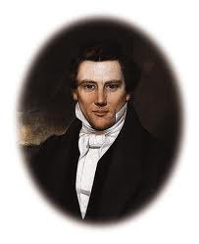
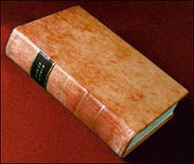
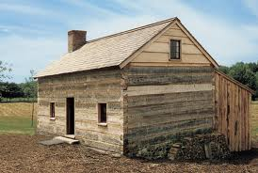
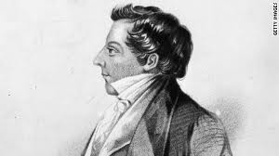
The Situation
In New York, Joseph Smith organized the Church of Jesus Christ of Latter-Day Saints (LDS Church) in the early 1830’s.
Many people did not believe Joseph Smith and made fun of him but many others listened to his message and started a new life with the Mormons.
Thousands of converts—men, women, and children—came to join the gathering.

Slide 4
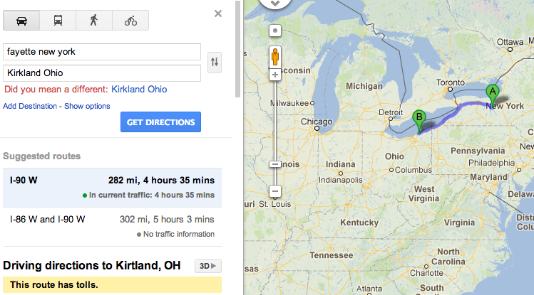
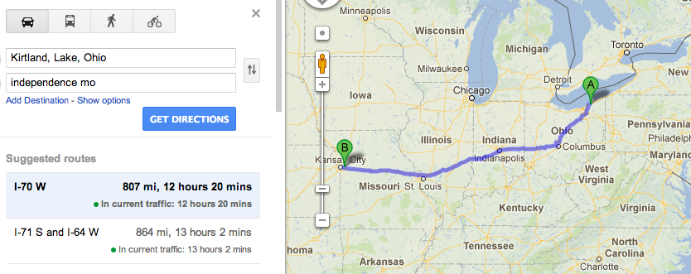
The Church moved from Fayette, New York to Kirtland, Ohio and Independence, Missouri in 1831

Slide 5
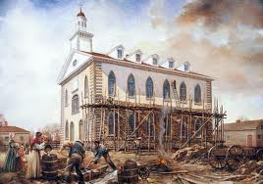
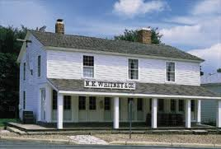
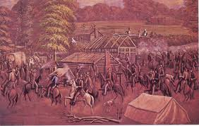
The gathering continued in Ohio and Missouri, but some of the same old problems arose. Soon mobs drove the people from Ohio.
Things got so bad…that Missouri’s Governor Boggs gave an extermination order. He said that all the Mormons must move or be killed.

Slide 6
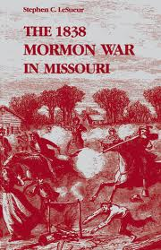
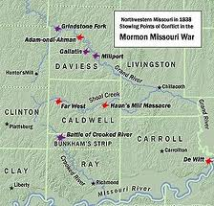
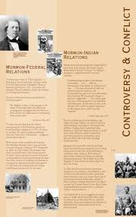
Conflict and Misunderstanding
Name 6 Reasons there was conflict between Mormon communities and their neighbors.
Religion: The Mormon’s told others that their church was God’s only true church…This upset people of other religions, who said Joseph Smith made up the things he was saying
Social: A man might be married to more than one wife. That way of living seemed very wrong to other people
Politics: The Mormons often outnumbered their neighbors.

Slide 7
Conflict and Misunderstanding
Name 6 Reasons there was conflict between Mormon communities and their neighbors.
Politics: In elections, the Mormons usually voted for the same people.
Politics and Social: Mormon church leaders also ran for local political position.
Social: Mormons lived a cooperative lifestyle which meant that everyone gave what they had to the Church for the good of the group, and this gave the leaders a lot of power.

Slide 8
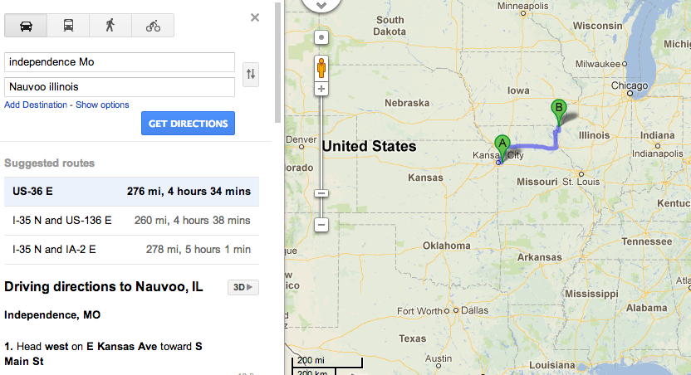
From Ohio and Missouri, the Saints moved to Illinois where they founded a new city they called Nauvoo, which means beautiful.

Slide 9
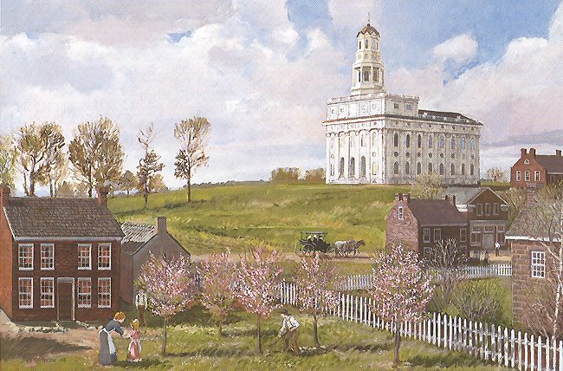
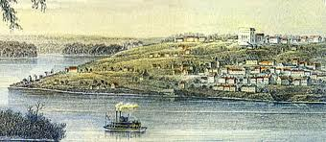
Nauvoo, Illinois
"The place was literally a wilderness. The land was mostly covered with trees and bushes, and much of it was so wet that it was with the utmost difficulty that a footman could get through, and totally impossible for teams. Commerce was unhealthy, very few could live there; but believing that it might become a healthy place by the blessing of heaven to the saints, and no more eligible place presenting itself, I considered it wisdom to make an attempt to build up a city" (Joseph Smith quoted in B.H. Roberts, A Comprehensive History of the Church, 2:9).

Slide 10
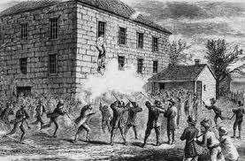
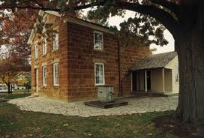
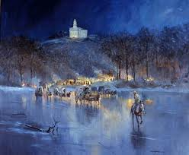
In Nauvoo, the same problems arose. While Joseph Smith was under arrest, a mob attacked the prison and shot and killed Joseph and his brother, Hyrum.
The rest of the Mormons were told to leave Nauvoo in the middle of the winter.
It was so cold that year that the Mississippi River froze solid.

Slide 11
Choice #1
Stay in Nauvoo
Go West!
You can try to stick it out and see if things calm down. You are nervous about moving everything again.
Going west is a hassle, but you believe in your leaders and want to find a place where you won’t be attacked by mobs.

Slide 12
Choice #1: Wrong! ☹
If you stay, your houses, barns and businesses are burned to the ground.
You are tarred and feathered for your beliefs.
You have no money, no friends, no protection.
Return

Slide 13
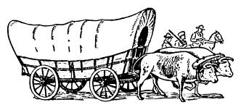
Choice #1: Correct! ☺
You decide to move with the other Mormon pioneers. You have to give up your comfortable home you have just built in Nauvoo.
You have to sell what you can to get enough money to buy enough supplies for the journey.

Slide 14
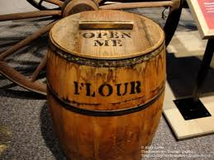
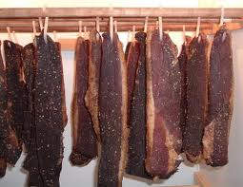
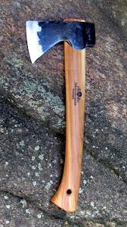
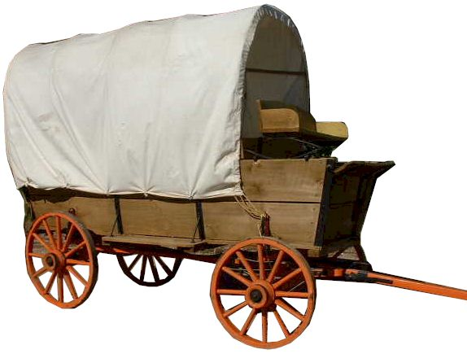
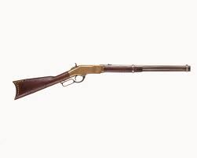
Supplying your Wagon
http://www.usda.gov/factbook/chapter1.htm
Your wagon can only hold 2,500 lbs, but you have to rebuild your entire life. What are you going to take?
Remember most families had 5 or more children to feed along the way. Assume you must feed 7 people.
According to US Department of Agriculture the average American eats close to 2.5 lbs/food each day.
Your Journey is 1250 miles form Nauvoo to Salt Lake City. You can travel about 20 miles on a good day. Most Mormons did not travel on Sundays.

Slide 15
TOOLS | lbs | Personal Items | lbs | Food | lbs | Food | lbs | Household Goods | lbs | Household Goods | lbs
ax | 15 | doll | 2 | flour | 150 | vinegar | 25 | coffee grinder | 5 | wooden bucket | 10
shovel | 12 | jump rope | 1 | tea | 10 | pickles | 50 | rug | 40 | butter mold | 1
hatchet | 9 | marbles | 1 | salt | 50 | dried beef | 25 | bedding | 20 | rocking chair | 50
hammer | 7 | family Bible | 2 | sugar | 50 | salt pork | 5 | mirror | 40 | pitcher and bowl | 5
hoe | 3 | books | 2 | coffee | 100 | assorted spices | 5 | dutch oven | 70 | cooking stove | 700
anvil | 150 | hunting knife | 1 | bacon | 40 | barrel of water | 200 | butter churn | 40 | cooling utensils | 2
grinding stone | 75 | bag of clothes | 40 | dried fruit | 100 | vegetables | 5 | table and 4 chairs | 200 | stool | 10
animal trap | 15 | fiddle | 2 | dried beans | 100 |  |  | piano | 900 | spinning wheel | 80
rope | 4 | snowshoes | 8 | cornmeal | 10 |  |  | organ | 2000 | lantern | 4
Spare wagon axle | 30 | first aid kit | 3 | spit peas | 100 |  |  | baby cradle | 75 | clock | 1
rifle | 10 |  |  | oatmeal | 8 |  |  |  |  | 10 candles | 1
pistol | 7 |  |  |  |  |  |  |  |  | set of dishes | 40

Slide 16
Reflection
Explain why you chose to bring along 3 things from your list.
Choose 2 things you think you would have wanted to bring if there was space, why would it have been hard to leave these items behind?

Slide 17
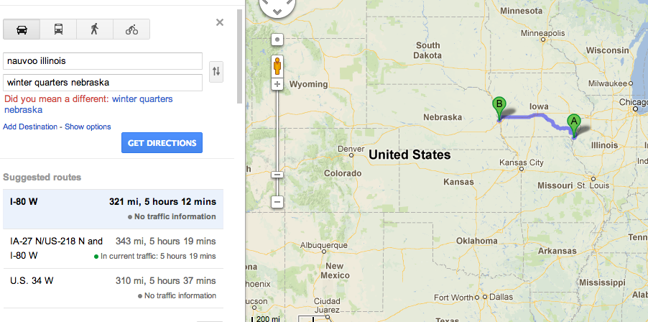
The 300 miles from Nauvoo to Winter Quarters was some of the harshest experiences of the whole trek.

Slide 18
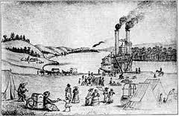
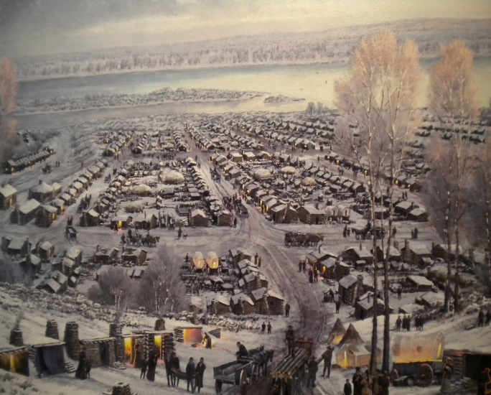
Winter Quarters, Nebraska
"[I] went through the City—where, nine weeks ago there was not a foot path, or a Cow track, now may be seen hundreds of houses, and hundreds in different stages of completion—impossible to distinguish the rich from the poor. The Streets are wide and regular and every prospect of a large City being raised up here" (Thomas Bullock, as quoted in Richard E. Bennett, Mormons at the Missouri, 1846-1852: "And Should We Die . . . " [1987], 80-81).
Notes:
Winter Quarters Distance: 266 miles from Nauvoo
An instant city on the plains, Winter Quarters served as the headquarters of the Church for less than a year, until the leadership moved west in 1847. By Christmas 1846, Church members had constructed a large stockade and about 700 homes ranging from solid two-story structures to simple dugouts in the bluffs. For many, however, the rigors of the Iowa crossing, exposure, and poor nutrition and sanitation proved too much, and several hundred saints died during the winter of 1846–1847.
Of the entire trek to the Valley of the Great Salt Lake, it was the first 300 miles across Iowa that most tried the stamina, courage and equipment of the Latter-day Saint pioneers. Mere weeks into the journey—through sleet, blizzard, and mud—it became apparent to Brigham Young that his people would never reach the Rocky Mountains in the time or in the manner that most had hoped for. So throughout the spring of 1846, thousands of refugees trudged across the windswept Iowa prairies, preparing the way for those yet to come: building bridges, erecting cabins, planting and fencing crops. By mid-June, nearly 12,000 Saints were still scattered across Iowa.

Slide 19
Test Fate (take a card/roll dice)
Sickness or blisters
25% of your vegetables and bacon spoil
Safe journey
Angry Mob
Fresh Buffalo Meat add 100 lbs meat to your supplies.
Hit bad winter snows, slows your journey by 2 days, subtract 50 lbs of food from your supplies.

Slide 20
Choice #2
You are sick and tired from the 300 mile trek. You don’t want to go on any longer and figure that settling in Winter Quarters is just as good as any other place.
You can continue to move on. Things are rough now, but you don’t want to be stuck in Iowa forever.
Stay
Go!

Slide 21
Choice #2: Wrong! ☹
Since you’ve decided to stay, you only experienced sickness and disease. You and your family experience scurvy, consumption, chills and fevers and many of your family members die.
"Winter [1846–1847] found me bed-ridden, destitute, in a wretched hovel which was built upon a hillside; the season was one of constant rain; the situation of the hovel and its openness, gave free access to piercing winds and water flowed over the dirt floor, converting it into mud two or three inches deep; no wood but what my little ones picked up around the fences, so green it filled the room with smoke; the rain dropping and wetting the bed which I was powerless to leave" (Margaret Phelps, as quoted in Richard E. Bennett, Mormons at the Missouri, 1846-1852: "And Should We Die . . . " [1987], 79–80).
Return

Slide 22
Choice #2: Correct! ☺
You spend the winter of 1846-1847 at Winter Quarters and get out of there as soon as it is spring. You leave crops and houses for Saints who will come after you. Your next destination is the Platte River, Nebraska

Slide 23
Test Fate (take a card/roll dice)
Sickness or blisters
25% of your vegetables and bacon spoil
Safe journey
Angry Mob
Fresh Buffalo Meat add 100 lbs meat to your supplies.
Hit bad winter snows, slows your journey by 2 days, subtract 50 lbs of food from your supplies.

Slide 24
Choice #3: Platte River, Nebraska
You can go on the north side of the river, to avoid other pioneers headed west to Oregon and California. You’ve also heard it’s healthier on the northern side.
You can choose to follow the south side of the river. It’s the one that everyone headed west uses, so it’s well marked.
Go North!
Go South!

Slide 25
Choice #3: Wrong! ☹
Following the south side of the river means that you are constantly competing with other pioneers for food, fuel and space. Former mob members find you on the south side and burn your wagon and steal your oxen.
Return

Slide 26
Choice #3: Correct! ☺
You follow the North side of the Platte River and avoid any unpleasant confrontations with other pioneers. You make your way to Chimney Rock in Western Nebraska.

Slide 27
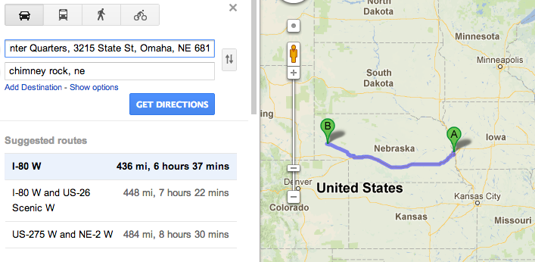
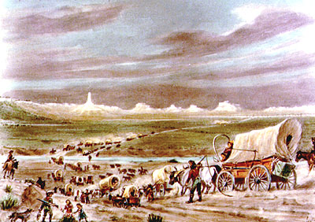
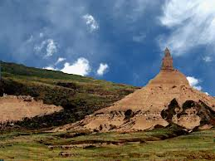

Slide 28
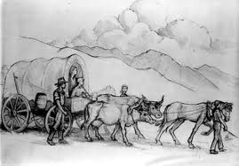
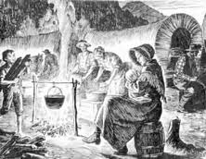
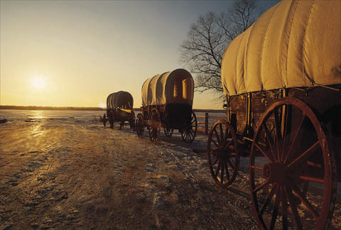
Chimney Rock, Nebraska
"The Mormon corral presents a lively, interesting scene. Three hundred men, women and children grouped within the space occupied by the encircled wagons very naturally making it so. A few of the families have small tents that are put up both inside and outside the corral; the rest sleeping either in their wagons or under them. The whole outfit is divided into messes of convenient size, and, as soon as camp is located, the first thing to do is to start the fires; those whose duty it is to provide fuel foraging around in every direction for 'chips,' sage brush, or any other material available, and soon forty of fifty bright little fires are twinkling inside and outside the corral, with coffee pots, frying pans, and bake ovens filling the air with appetizing incense…as one approaches nearer there is usually the sound of revelry. In every Mormon train there are usually some musicians, for they seem to be very fond of song and dance, and as soon as the camp work is done the younger element gather in groups and 'trip the light fantastic toe' with as much vim as if they had not had a twenty mile march that day" (The Diaries of William Henry Jackson: Frontier Photographer, ed. LeRoy R. Hafen and Ann W. Hafen [1959], 64–65).

Slide 29
Test Fate (take a card/roll dice)
Sickness or blisters
25% of your vegetables and bacon spoil
Safe journey
Angry Mob
Fresh Buffalo Meat add 100 lbs meat to your supplies.
Hit bad winter snows, slows your journey by 2 days, subtract 50 lbs of food from your supplies.

Slide 30
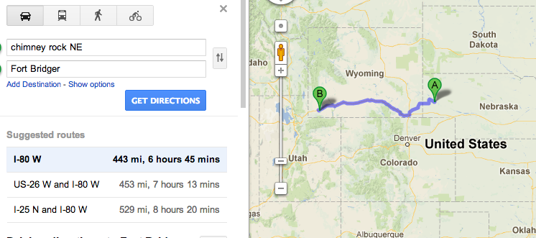
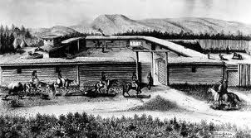
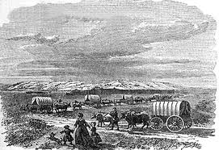
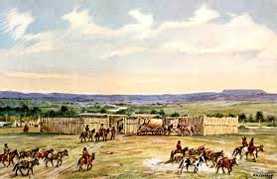

Slide 31
Choice #4: Fort Bridger, Wyoming
You can choose to rest and restock at the famous mountain man’s fort.
You can decide to push forward to Salt Lake City. It’s only a 100 more miles to the west.
Rest and Restock
Keep on Truckin!

Slide 32
Choice #4: Wrong! ☹
By pushing on ahead, you and your team are too exhausted to make the last attempt over the Wasatch Mountains and through Emigration Canyon. You die, exhausted, barely within reach of you destination.
Return

Slide 33
Choice #4: Correct! ☺
"Next day campt on Hams Fork, then to Blacks Fork [and] from the[re] to Fort Bridger. Old Jim Bridger and his trappers gave us a hearty welcome to our company. He is the oldest trapper in the mountains and can tell some wonderful stories" (Frontiersman: Abner Blackburn's Narrative, ed. Will Bagley, [1992], 61).
By choosing to rest, restock and relax, you get the chance to meet the most famous mountain man, Jim Bridger, and get some much needed info about your new home, the Salt Lake Valley.

Slide 34
Test Fate (take a card/roll dice)
Sickness or blisters
25% of your vegetables and bacon spoil
Safe journey
Angry Mob
Fresh Buffalo Meat add 100 lbs meat to your supplies.
Hit bad winter snows, slows your journey by 2 days, subtract 50 lbs of food from your supplies.

Slide 35
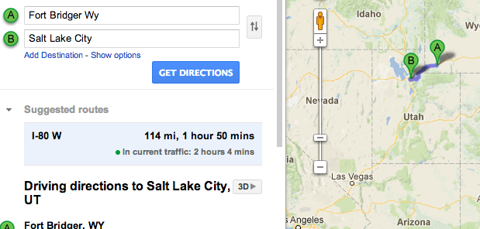
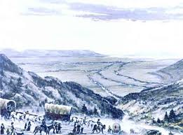
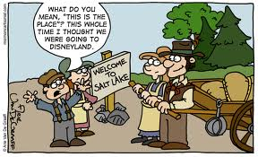
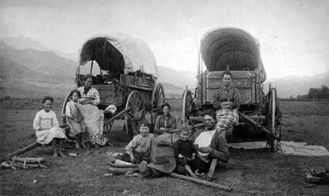

Slide 36
Salt Lake Valley, Utah
You’ve made it!
In the words of Pulitzer Prize-winning author and historian Wallace Stegner, the Latter-day Saints "were one of the principal forces in the settlement of the West" (The Gathering of Zion: The Story of the Mormon Trail [1964], 7).
Notes:
Great Salt Lake Valley—Emigration Square Distance: 1,297 miles from Nauvoo
Arrival in the Salt Lake Valley had a special meaning to each emigrant. For many it signified the end of their arduous journey. They had endured to the end of the Mormon Trail, and their participation in that memorable trek gave metaphor and meaning to life itself. Even for those who were not Latter-day Saints, the first glimpse of this broad, open valley after such hardship provided a deeply emotional moment.
"But not all of the pioneering Saints settled in the Salt Lake Valley." By 1900, members of The Church of Jesus Christ of Latter-day Saints had founded more than 600 communities in a broad stretch extending from Canada into Mexico. In the words of Pulitzer Prize-winning author and historian Wallace Stegner, the Latter-day Saints "were one of the principal forces in the settlement of the West" (The Gathering of Zion: The Story of the Mormon Trail [1964], 7).

Slide 37
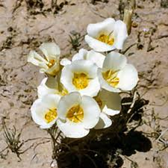
I turned and looked back. There were more people…than I had seen since I left the Missouri River. Where did they come from? How did they get here? I pinched myself to make sure that I was not dreaming. I have seen tables set for probably 100 or more, but here were tables for thousands. But the greatest marvel is how they could, in so short a time, produce in a desert, the variety of food stuffs with which the tables were spread. Men do not gather vegetables from sage brushes or cereals from cactus. The seeds, the tubers, the roots, the fouls, the pigs, the sheep, the cows, everything from which this abundance was produced had to all be transported a thousand miles or more over such roads as we have traveled. Even then, how could they in so short a time with so small a beginning, have produced so much. It seems incredible. I take off my hat to those who planned and executed it" (Diary of John H. Benson, May–Sept. 1849, typescript, Family and Church History Department Archives, The Church of Jesus Christ of Latter-day Saints, 48–51).

Slide 38
Exit Slip – Answer these three questions on a sheet of lined paper to hand me on your way out
What are 2 reasons Mormons did not get along well with their neighbors?
What were some challenges faced by pioneers travelling west?
What are 2 major points along the trail travelled by Mormon pioneers?

