Slide 1
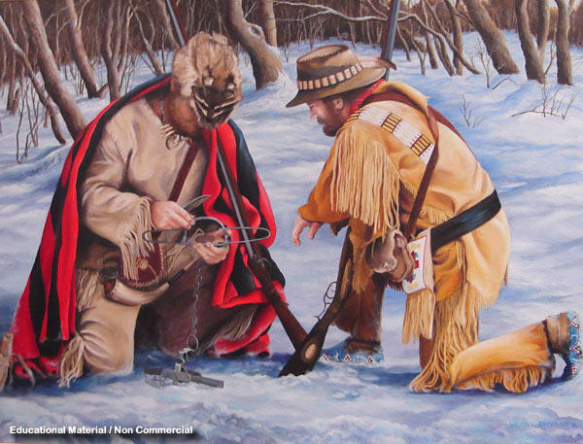
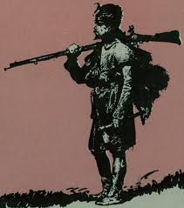
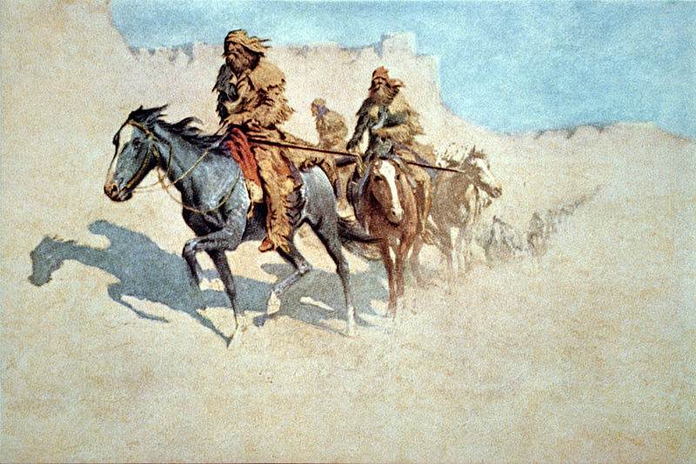
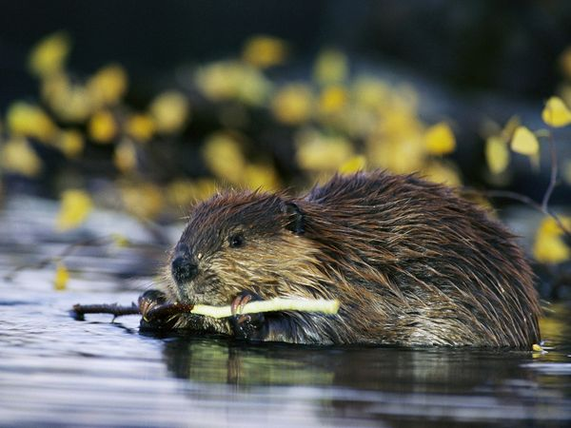
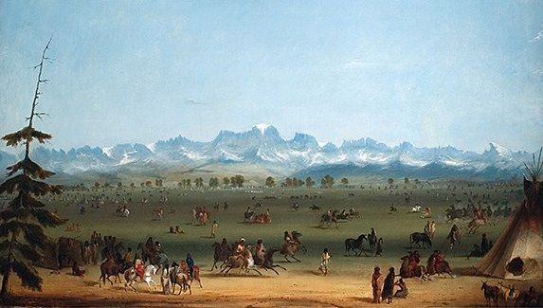
Warm Up for 2-6 & 2-7
Please answer the following question(s) in 6-8 COMPLETE sentences:
Have you ever done anything really adventurous? Think of the most adventurous thing you have done, or the most adventurous thing you really want to do, is there or was there any danger involved? What kinds of danger? What makes this thing so adventurous? Often times adventures include some challenges, what challenges were involved with your adventure?

Slide 2
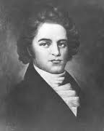
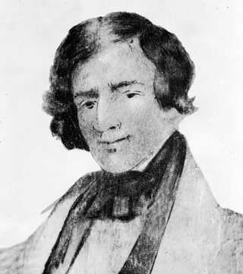
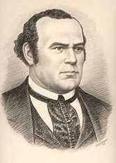
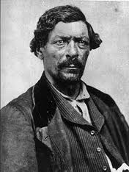
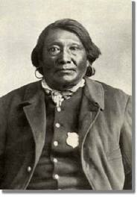
The most adventurous of 19th century Americans

Slide 3
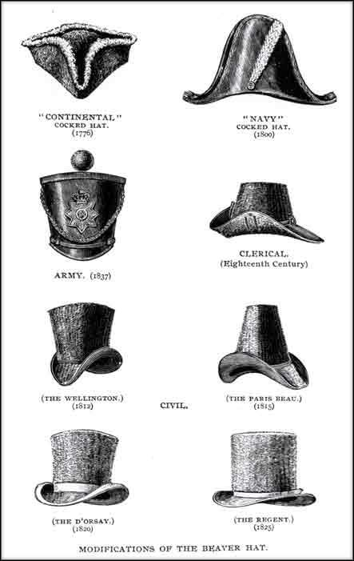
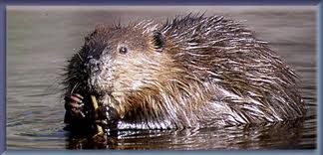
Why would all these men and a lot more risk everything?
Notes:
Why would the trappers face all these dangers? Just to be adventurous? I do not think so really the answer is… french fashion! Obviously not fashion the way we know it today but fashion of the 1800s. Fur hats were all the rage. The best fur to make a hat? Beaver.

Slide 4

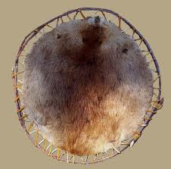
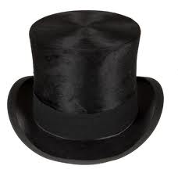
Notes:
Beaver fur = money. Pure and simple, trappers will willing to risk everything, indians, frostbite, bears and all to earn cash, often they could make more than people from a similar background would make in three years back east.

Slide 5
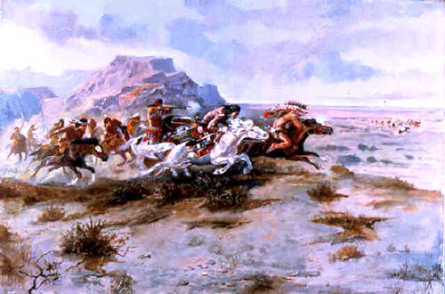
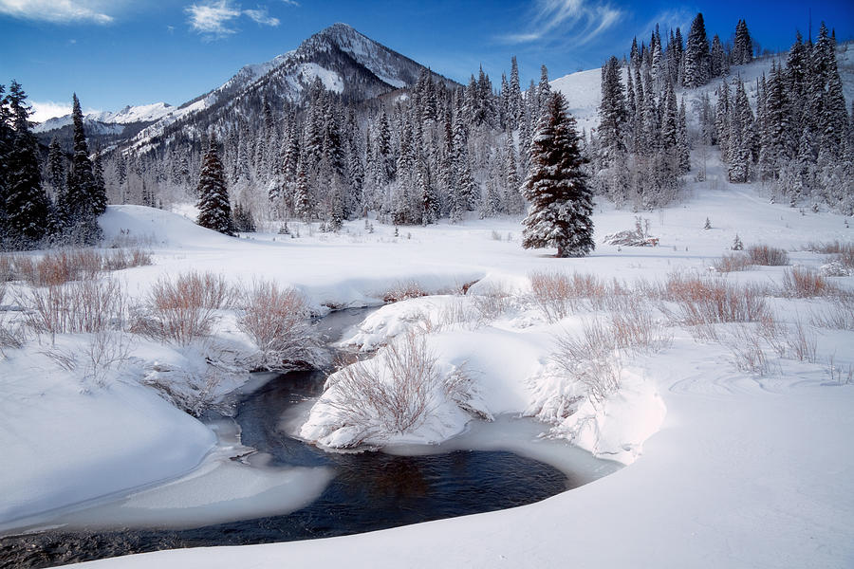

Adventure is often dangerous
Notes:
Dangers that were often faced by the mountain men were possibilities of Indian Attack, Getting caught in the wild for winter and mountain snowstorms, the possibility of getting lost and not being able to find your way, and grizzly bears to name a few. The bear image is a 5 minute video that will play when clicked.

Slide 6
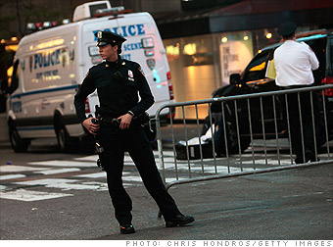
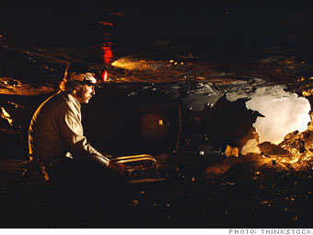
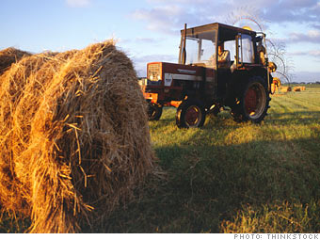
What are some dangerous jobs people have in Utah today?
Not one of Utah’s most dangerous jobs is as dangerous as being a trapper in 1800s.
Fatality rate per 100,000 workers: 18
Median wage: $55,620
Fatality rate per 100,000 workers: 39
Median wage: $39,950
Fatality rate per 100,000 workers: 41
Median wage: $65,960
Notes:
This slide is used to compare current dangerous jobs in Utah to the dangers of trapping. The jobs and statistics came from a cnn article last year.

Slide 7
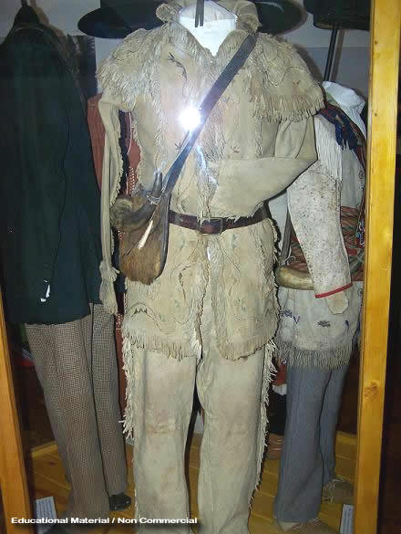
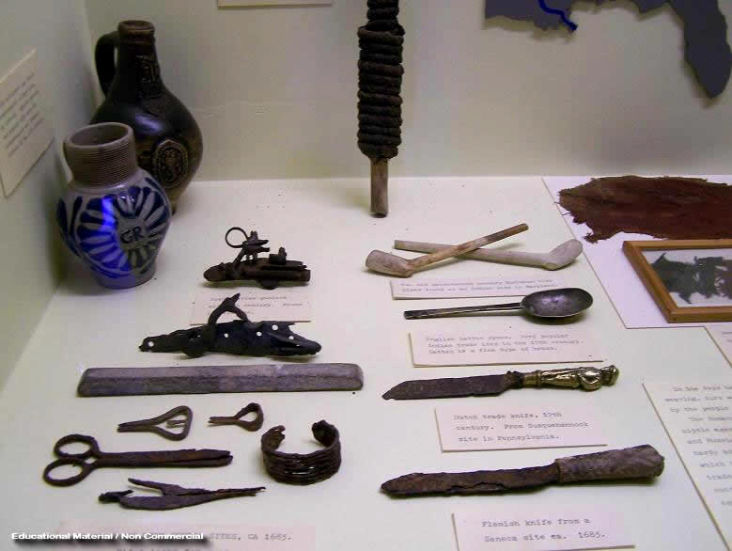
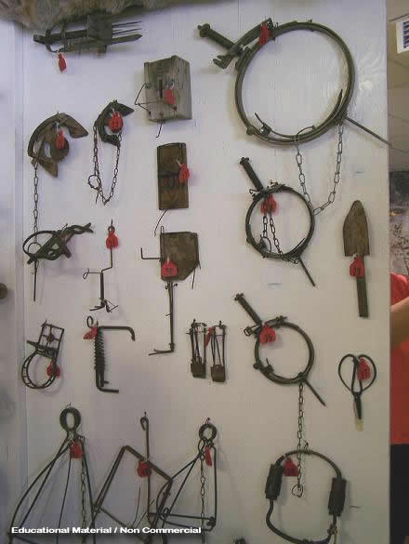
Notes:
This slide is pictures from a mountain men museum in wyoming. Shows clothes, indian trade items, and traps.

Slide 8
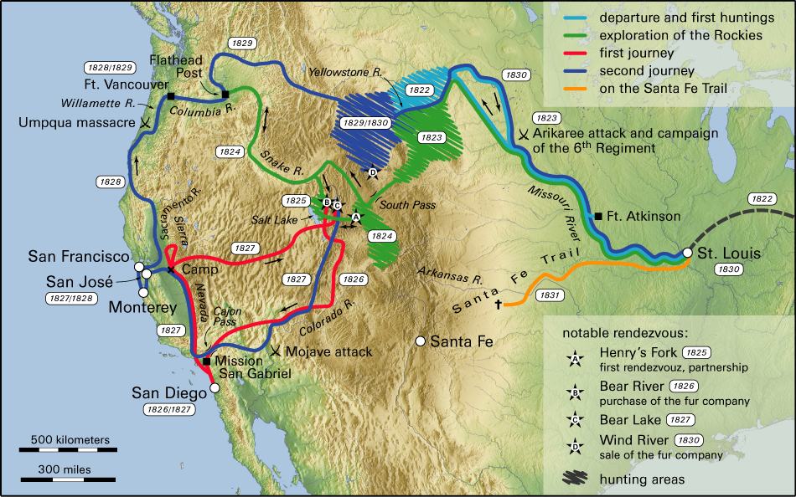
Notes:
This is a map of Jedidiah smith’s travels through and around Utah. Can show the kids how much these men traveled on foot and on horse long before modern transportation.

Slide 9
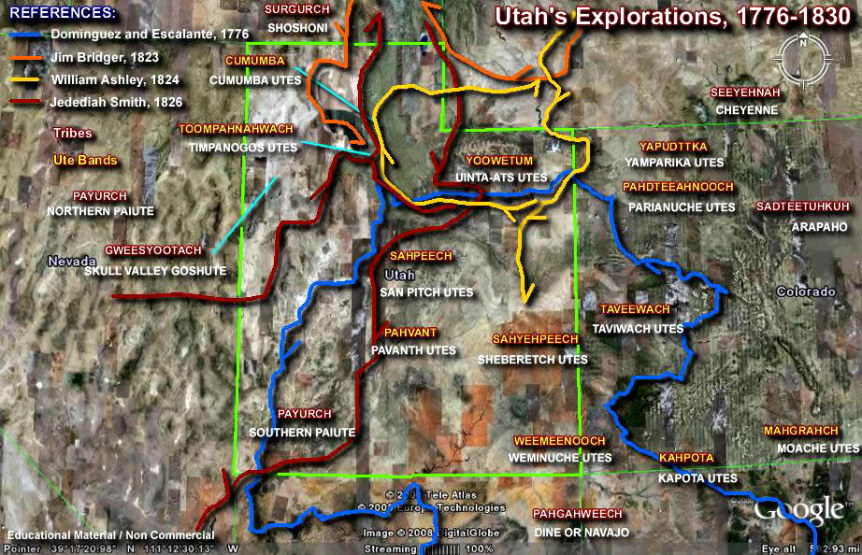
What did the mountain men and trappers contribute to the settlement of Utah?
How would the trails developed by the mountain men contribute to the settlement of Utah?
Notes:
Then, really the crux of the lesson is the idea that trappers opened the west to other travelers, this map shows the travel routes of some of the trappers and makes an easy comparison to I-15 today and settlement patterns in Utah. Also shows Indian tribes so could be a quick review for where the tribes are located.

Slide 10
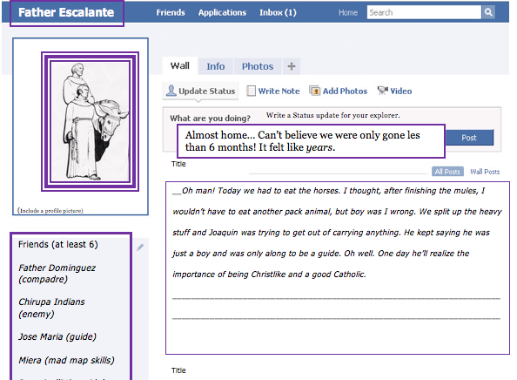

Slide 11
